Slide 1


Slide 2
Content
What is Git?
Version Control System
Version Control Types
Git Work Flow
Role of Git in your projects
Git Operations and Commands
Create a GitHub Repository
Hands on Working

Slide 3

What is Git?
GIT means Global Information tracker. It is free and open source tool
Git is a SCM(Source Code Management), where it stores all files in repository(local/server)
Git is a version control system for tracking changes in computer files and created in 2005 by Linus Torvalds creator of Linux kernel. Now it is maintained by Junio Hamano.
Git is a Distributed Version Control System that work on a single project without having to be in a same network. It is not dependent on network access or a central server.
Git Co-ordinates work between multiples of developers and tracks every single version, changes and history that made on the system files/projects.
Git can be revert back to any specific version of any file at any time as long as it is stored in repository.
Using Git you will have Repository in local machine, where you will do changes and commit, the push that file to Remote Repository like Git Hub or Bit Bucket.

Slide 4
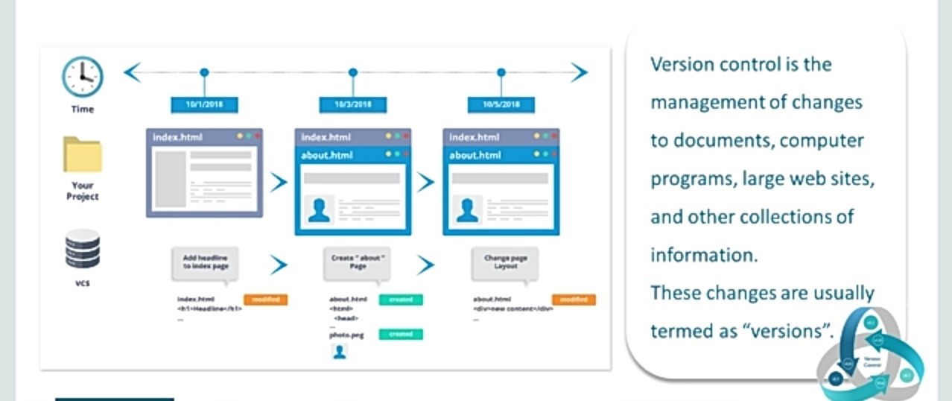
VERSION CONTROL SYSTEM
Version Control System (VCS) is a software that helps software developers to work together and maintain a complete history of their work.
Some of the feature of VCS as follows:
Allow developers to wok simultaneously
Does not allow overwriting on each other changes.
Maintain the history of every version.

Slide 5
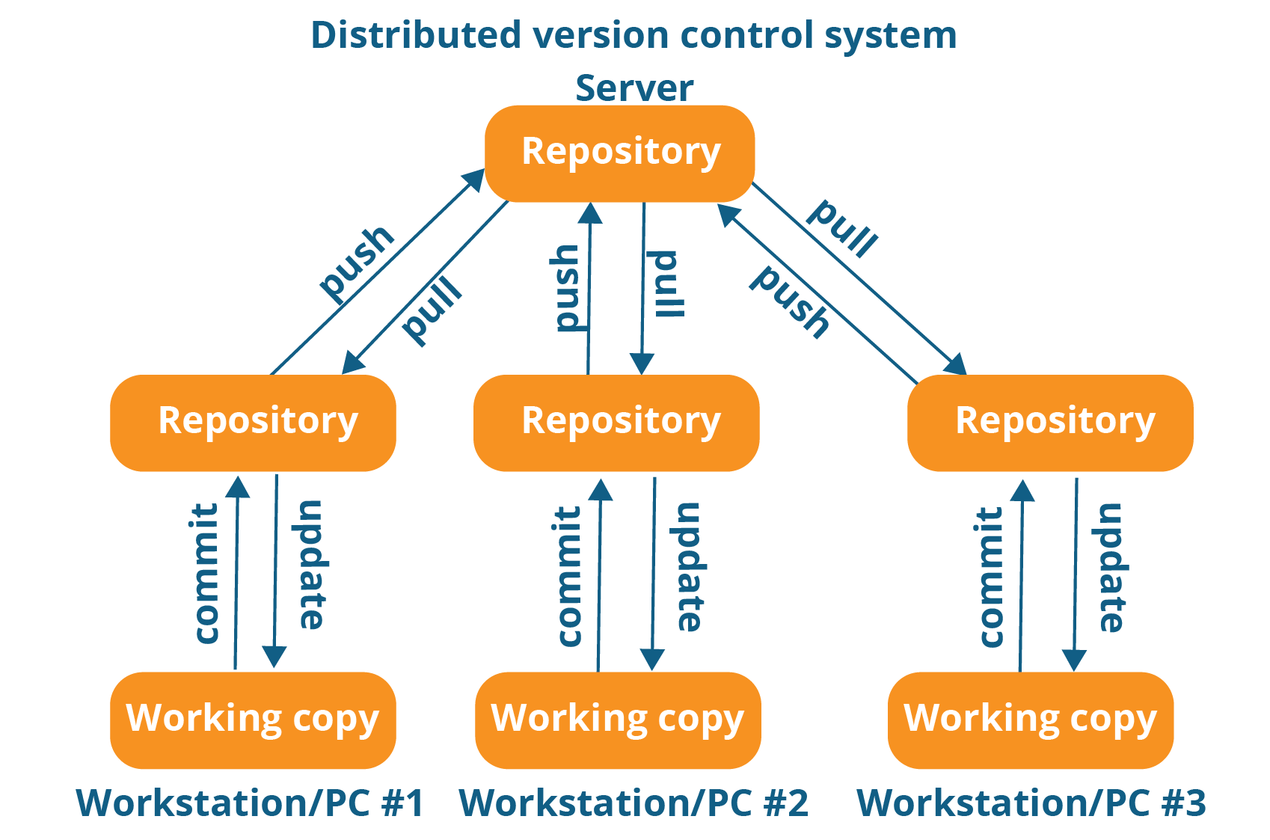
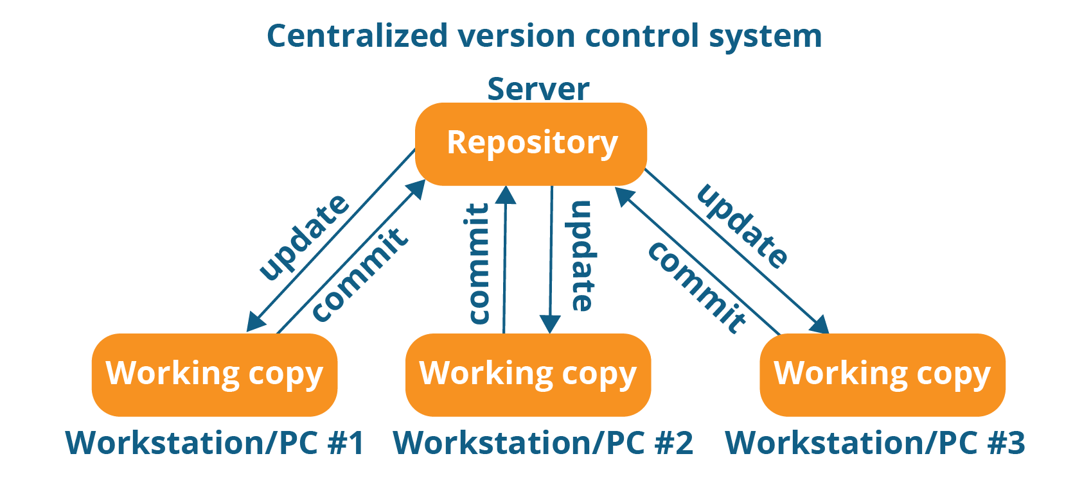
Version Control Types
There are two types of Version Control Systems:
Distributed/Decentralized Version Control System Ex: Git, Bitbucket Central Version Control System Ex: SVN
Centralized version control system (CVCS) uses a central server to store all files and enables team collaboration. It works on a single repository to which users can directly access a central server.
In Distributed VCS, every contributor has a local copy or “clone” of the main repository i.e. everyone maintains a local repository of their own which contains all the files and metadata present in the main repository.
They can update their local repositories with new data from the central server by an operation called “pull” and affect changes to the main repository by an operation called “push” from their local repository.

Slide 6
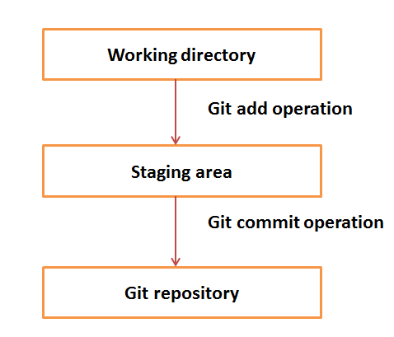
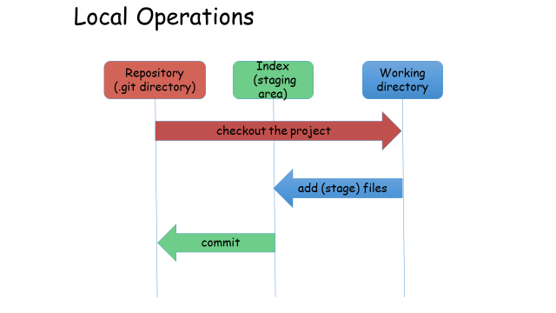
Git – Work flow
The workflow of Git.
Step 1 − You modify a file from the working directory.
Step 2 − You add these files to the staging area.
Step 3 − You perform commit operation that moves the files from the staging area. After push operation, it stores the changes permanently to the Git repository.

Slide 7

Role Of Git In Projects
Plan
Code
Shared Repository
Continuous Integration
Monitor
Build
Configuration Management
Deploy
Test
Tools like Git enable communication between the development and the operations team. When you are developing a large project with a huge number of collaborators, it is very important to have communication between the collaborators while making changes in the project. Commit messages in Git play a very important role in communicating among the team. The bits and pieces that we all deploy lies in the Version Control system like Git. To succeed in DevOps, you need to have all of the communication in Version Control. Hence, Git plays a vital role in succeeding at DevOps.

Slide 8

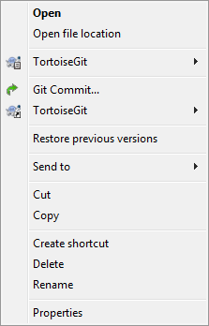

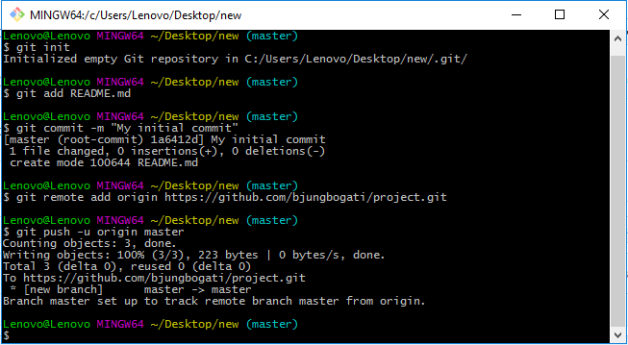
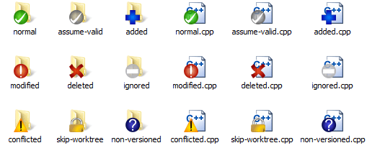
Tools Used in GIT
1)Git Bash with Command Prompt
2)Tortoise Git

Slide 9
GIT common Commands
Commands: −
$git init -> Create an empty Git repository
$git config –global user.name “name”->
$git config –global user.email “email”->
$git add “file name”-> add file to your staging area.
$git commit –m ”1st message”-> Commit a stage file.
$git status -> to see the state of your files(add, modified, remote).
$git log->to get history of your commits or commits made by someone else.
$git remote add origin”link”->Add the URL link from GitHub.
$git push origin master->pushes the file from local repo to Git hub(server).
$git pull origin master->pulls the files from Git hub to local area repo.
$git push –f -u origin master-> pushes the updated & force file from local repo to Git hub server.

Slide 10
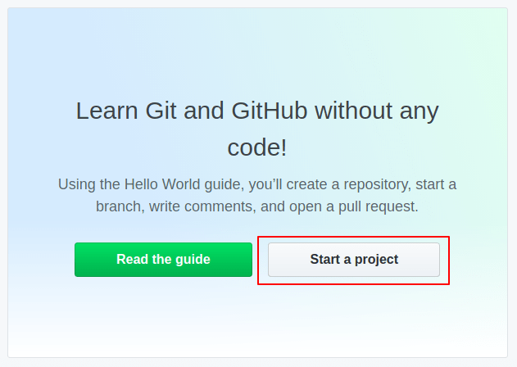
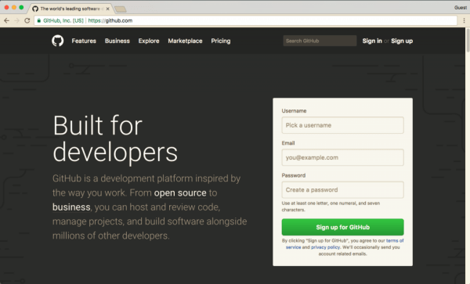
Create GitHub Repository
https://github.com/github

